Slide 1
Data Visualization
BS DATA SCIENCE
Charts that answer a question
W07-S01 · Introduction to Data Science
Notes:
Guide W07-S01. Quiz 3 first, then tell the missing-axis story.

Slide 2
Q2 looked three times taller than Q1.
It was 4 percent higher. The axis started at 470.
A chart can be accurate in every number and still mislead.
W07-S02 · Introduction to Data Science
Notes:
Guide W07-S02. Tell the full story from the guide before advancing.

Slide 3
Today you will
Ask
Choose
Build
Start every chart with a question
Match the question to the chart type
Matplotlib and Seaborn, step by step
Judge
Tell
Spot and fix misleading charts
Titles that say the finding
Deliverable: five charts from one dataset, each with a question and an insight title.
W07-S03 · Introduction to Data Science
Notes:
Guide W07-S03. The question-first habit is the objective.

Slide 4
A chart is the answer to a question
1 Question
2 Chart
3 Check
Which department earns the most?
Compare categories: a sorted bar chart
Axis from zero? Labels? Could it mislead?
If you cannot state the question in one sentence, you are not ready to draw the chart.
W07-S04 · Introduction to Data Science
Notes:
Guide W07-S04. Ask students for the question behind a chart they saw this week.

Slide 5
Choosing the chart
The question | Use | Avoid
How do categories compare? | Bar chart, sorted | Pie with many slices
How does it change over time? | Line chart | Bars for a long series
How is it distributed? | Histogram or box plot | Averages only
Are two numbers related? | Scatter plot | Two lines on two axes
What share is each part? | Stacked bar, a few parts | 3D pie
W07-S05 · Introduction to Data Science
Notes:
Guide W07-S05. Each row is a rule of thumb, not a law.

Slide 6
Drill: pick the chart
Monthly revenue over two years
Revenue by department
Study hours against exam mark
How salaries are spread across a company
Decide alone for one minute, then compare with a neighbour. Defend your choice.
W07-S06 · Introduction to Data Science
Notes:
Guide W07-S06. Cold-call three students for reasons.

Slide 7
Drill: the answers
Situation | Chart | Why
Monthly revenue, two years | Line | Order and trend matter
Revenue by department | Horizontal bar, sorted | Compare categories; long labels
Study hours and mark | Scatter | Two numbers, one point per student
Salary spread | Histogram or box plot | Shape and outliers, not just a centre
There can be more than one good answer. There is always a reason.
W07-S07 · Introduction to Data Science
Notes:
Guide W07-S07. Accept any defensible answer with a reason.

Slide 8
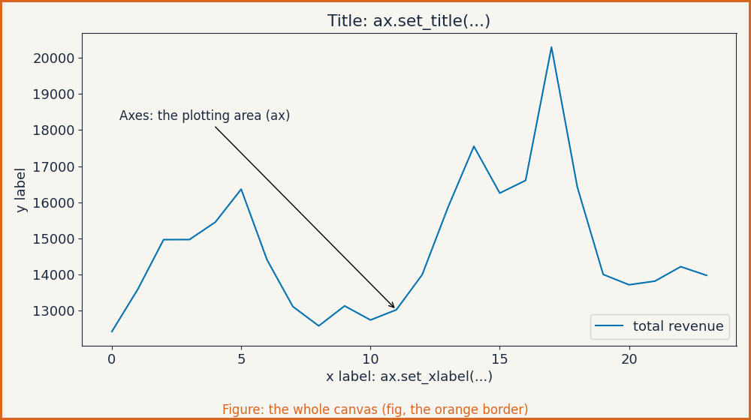
Matplotlib: figure and axes
fig, ax = plt.subplots(figsize=(8, 4)) # fig: canvas, ax: one chart
ax.plot(x, y)
ax.set_title('...'); ax.set_xlabel('...'); ax.set_ylabel('...')
fig.savefig('chart.png', dpi=150)
W07-S08 · Introduction to Data Science
Copy this code: Code Pack, W07-S08
Notes:
Guide W07-S08. Point at each part of the image.

Slide 9
A first chart: a line over time
import matplotlib.pyplot as plt
m = df.groupby('month')['revenue_k'].sum()
fig, ax = plt.subplots(figsize=(8, 4))
ax.plot(m.index, m.values, color='#0072B2')
ax.set_xticks(m.index[::3])
ax.set_ylabel('Revenue (Rs thousand)')
ax.set_title(f'Revenue peaked in {m.idxmax()}')
Group first, then draw. Show every third month on the axis so labels stay readable.
W07-S09 · Introduction to Data Science
Copy this code: Code Pack, W07-S09
Notes:
Guide W07-S09. Live code; ask what each line does before running.

Slide 10
A bar chart done well
d = df.groupby('department')['revenue_k'].sum().sort_values()
fig, ax = plt.subplots(figsize=(8, 4))
ax.barh(d.index, d.values, color='#0072B2')
ax.set_xlabel('Revenue (Rs thousand)')
ax.set_title(f'{d.index[-1]} earns {d.iloc[-1] / d.sum():.0%}')
Sorted. Horizontal because the labels are long. Starts at zero. The title says the finding.
W07-S10 · Introduction to Data Science
Copy this code: Code Pack, W07-S10
Notes:
Guide W07-S10. Ask what would change if it were not sorted.

Slide 11
Histogram and box plot
fig, (a, b) = plt.subplots(1, 2, figsize=(10, 4))
a.hist(df['revenue_k'], bins=30)
a.axvline(df['revenue_k'].median(), color='#D55E00')
data = [g['revenue_k'] for _, g in df.groupby('region')]
b.boxplot(data)
b.set_xticklabels(sorted(df['region'].unique()))
The number of bins changes the story. Try 10, 30 and 100 before you choose.
W07-S11 · Introduction to Data Science
Copy this code: Code Pack, W07-S11
Notes:
Guide W07-S11. Run with three different bin counts.

Slide 12
Scatter: two numbers, one dot per row
typical = df.groupby(['region', 'department'])['units'].transform('mean')
y = df['units'] / typical
fig, ax = plt.subplots()
ax.scatter(df['discount_pct'], y, s=12, alpha=0.5)
df['discount_pct'].corr(y) # 0.38
Divide by what is typical for the group, so a big department does not hide the pattern. Use alpha when dots overlap.
W07-S12 · Introduction to Data Science
Copy this code: Code Pack, W07-S12
Notes:
Guide W07-S12. Ask why raw units would hide the pattern.

Slide 13
Seaborn: statistical charts in one line
import seaborn as sns
sns.set_theme(style='whitegrid')
sns.barplot(data=df, y='department', x='revenue_k', estimator='sum')
sns.boxplot(data=df, x='region', y='revenue_k')
sns.histplot(data=df, x='revenue_k', hue='region', element='step')
Seaborn works on a DataFrame and does the grouping for you. Matplotlib gives you full control. Learn both.
W07-S13 · Introduction to Data Science
Copy this code: Code Pack, W07-S13
Notes:
Guide W07-S13. Run each line and compare with the Matplotlib version.

Slide 14
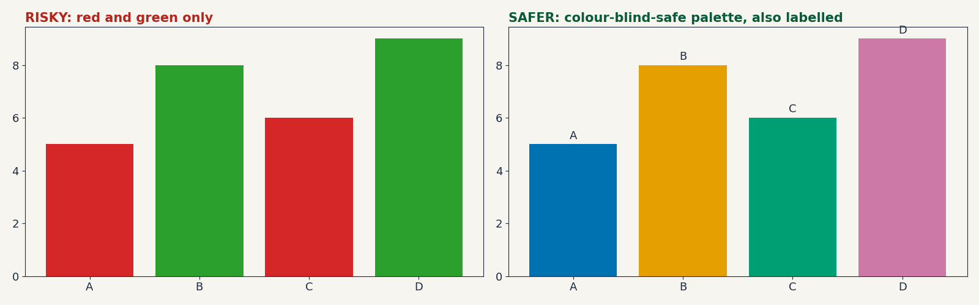
Colour: use it for meaning
Colour carries meaning, not decoration
Never rely on red against green
Label directly as well, so colour is not the only clue
W07-S14 · Introduction to Data Science
Notes:
Guide W07-S14. Ask students to name one chart they saw that relied only on red and green.

Slide 15
Small multiples: one chart per group
tot = df.groupby(['department', 'month'])['revenue_k'].sum().unstack(0)
fig, axes = plt.subplots(2, 3, figsize=(10, 5), sharex=True)
for ax, name in zip(axes.ravel(), tot.columns):
ax.plot(tot.index, tot[name])
ax.set_title(name)
ax.set_xticks(tot.index[::6])
Twelve lines in one chart is unreadable. Six small charts with the same axes can be compared at a glance.
W07-S15 · Introduction to Data Science
Copy this code: Code Pack, W07-S15
Notes:
Guide W07-S15. Compare with the spaghetti chart on the next slides.

Slide 16
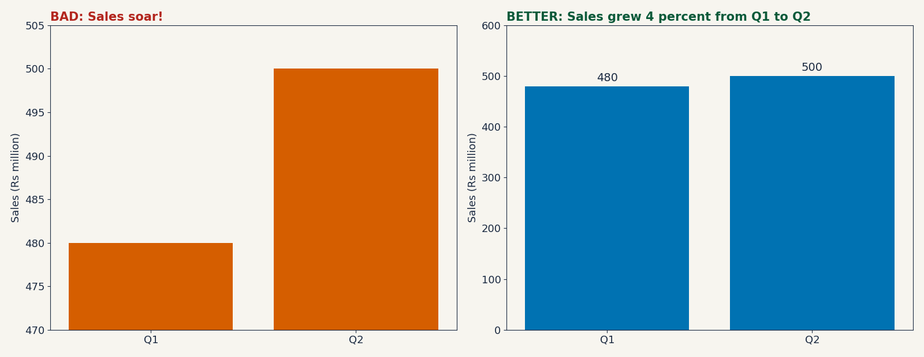
Bad Chart Museum 1: the missing axis
A bar encodes its length. Cutting the axis changes the story. Start bars at zero.
W07-S16 · Introduction to Data Science
Notes:
Guide W07-S16. Ask what the manager wanted the board to feel.

Slide 17
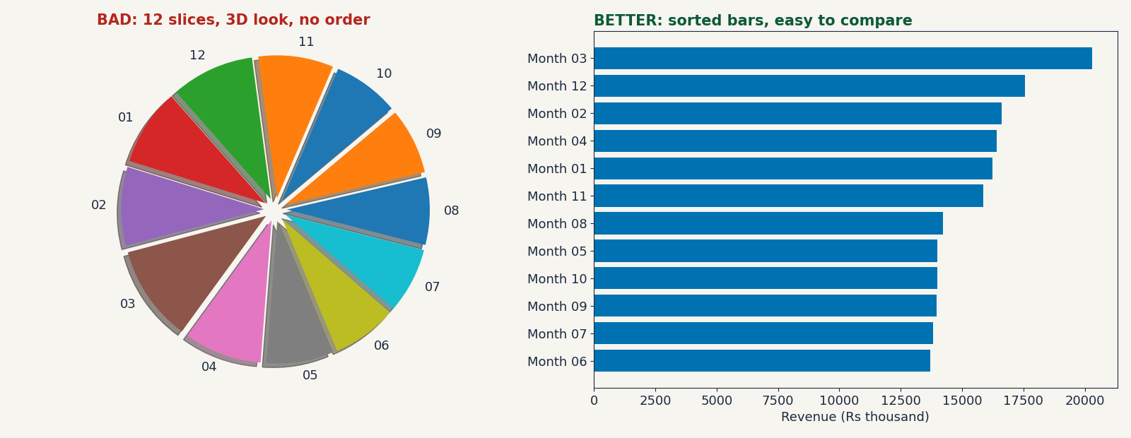
Bad Chart Museum 2: the crowded pie
Humans compare lengths well and angles badly. Sort the bars and the answer is obvious.
W07-S17 · Introduction to Data Science
Notes:
Guide W07-S17. Ask which month is largest in each version and how long each takes.

Slide 18
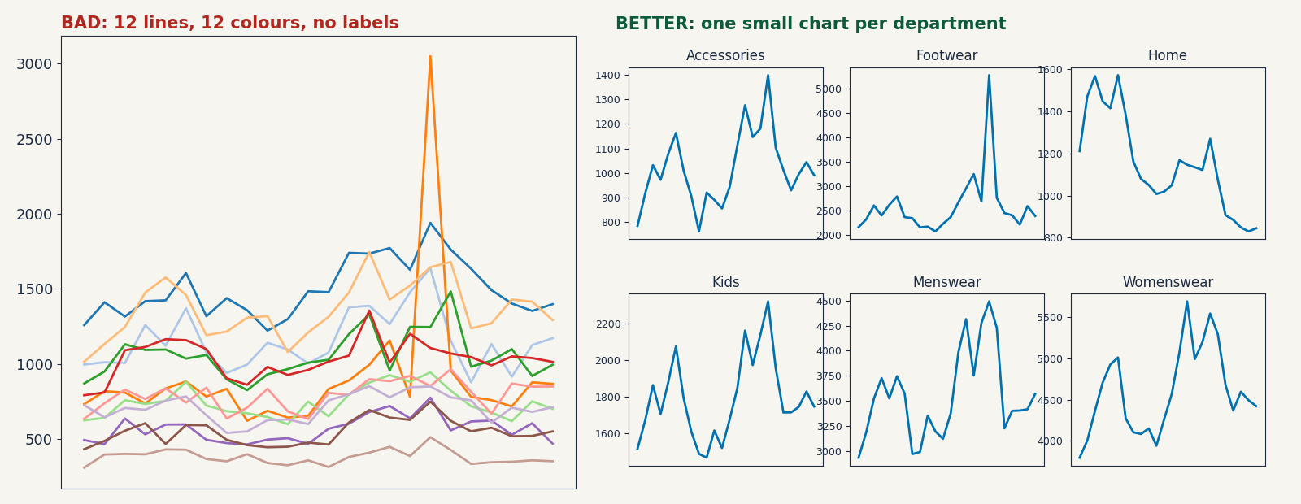
Bad Chart Museum 3: the spaghetti chart
Too many lines, too many colours, no labels. Split by group and share the axes.
W07-S18 · Introduction to Data Science
Notes:
Guide W07-S18. Ask students to read one series off each version.

Slide 19
Redesign checklist
Check | The fix
Does it answer one stated question? | Write the question in the notes
Is the title the finding? | Say what the chart shows
Do bars start at zero? | Always for bars
Are categories sorted and labelled? | Sort by value; label directly
Is colour doing a job? | Use at most one or two colours and a safe palette
Is anything decorative? | Remove it
W07-S19 · Introduction to Data Science
Notes:
Guide W07-S19. Students apply it to the museum charts.

Slide 20
Mini-lab: fix this chart
d = df.groupby('region')['revenue_k'].sum()
plt.bar(d.index, d.values)
plt.ylim(d.min() * 0.95, d.max() * 1.01)
plt.title('Regions')
Fix the axis, sort the bars, add axis labels
Write a title that states the finding
Say in one sentence what the original made you believe
W07-S20 · Introduction to Data Science
Copy this code: Code Pack, W07-S20
Notes:
Guide W07-S20. 10 minutes in pairs.

Slide 21
Lab: five charts, five questions
Data
Make
For each
shop_monthly.csv: 24 months, 4 regions, 6 departments
A line, a bar, a histogram, a box plot and a scatter plot
State the question, draw the chart, write an insight title, say what it cannot show
Foundation: three charts. Core: all five. Stretch: small multiples and a safe palette. 35 minutes.
W07-S21 · Introduction to Data Science
Notes:
Guide W07-S21. Load the data with %%writefile as before.

Slide 22
Plan the five charts
Chart | Question it answers
Line | When did revenue peak, and is there a trend?
Sorted bar | Which department earns the most?
Histogram | Are monthly revenues spread evenly or skewed?
Box plot | How do the regions compare, including spread?
Scatter | Do deeper discounts sell more units?
W07-S22 · Introduction to Data Science
Notes:
Guide W07-S22. Students write the five questions first.

Slide 23
Full code, part 1
001 from __future__ import annotations
002
003 from pathlib import Path
004
005 import matplotlib.pyplot as plt
006 import pandas as pd
007
008 OUT = Path('charts')
009 BLUE, ORANGE = '#0072B2', '#D55E00'
010
011
012 def save(fig: plt.Figure, name: str) -> None:
013 OUT.mkdir(exist_ok=True)
014 fig.tight_layout()
015 fig.savefig(OUT / name, dpi=150)
016 plt.close(fig)
017
018
019 def line_chart(df: pd.DataFrame) -> str:
020 m = df.groupby('month')['revenue_k'].sum()
021 fig, ax = plt.subplots(figsize=(8, 4))
022 ax.plot(m.index, m.values, color=BLUE)
023 ax.set_xticks(m.index[::3])
024 ax.set_ylabel('Revenue (Rs thousand)')
025 ax.set_title(f'Revenue peaked in {m.idxmax()} at {m.max():,.0f}k')
026 save(fig, '1_revenue_by_month.png')
027 return str(m.idxmax())
028
029
030 def bar_chart(df: pd.DataFrame) -> pd.Series:
031 d = df.groupby('department')['revenue_k'].sum().sort_values()
032 fig, ax = plt.subplots(figsize=(8, 4))
033 ax.barh(d.index, d.values, color=BLUE)
034 ax.set_xlabel('Revenue (Rs thousand)')
035 ax.set_title(f'{d.index[-1]} earns {d.iloc[-1] / d.sum():.0%} of revenue')
036 save(fig, '2_revenue_by_department.png')
037 return d
038
039
040 def hist_chart(df: pd.DataFrame) -> float:
041 s = df['revenue_k']
042 fig, ax = plt.subplots(figsize=(8, 4))
043 ax.hist(s, bins=30, color=BLUE)
044 ax.axvline(s.median(), color=ORANGE, label='median')
045 ax.set_xlabel('Monthly revenue per region and department (k)')
046 ax.set_title('Most rows are small; a few are very large')
047 ax.legend()
048 save(fig, '3_revenue_distribution.png')
049 return float(s.skew())
050
051
052 def box_chart(df: pd.DataFrame) -> pd.Series:
053 order = df.groupby('region')['revenue_k'].median().sort_values()
054 fig, ax = plt.subplots(figsize=(8, 4))
055 data = [df.loc[df['region'] == r, 'revenue_k'] for r in order.index]
056 ax.boxplot(data)
W07-S23 · Introduction to Data Science
Copy this code: Code Pack, file-week7.py
Notes:
Guide W07-S23. Compare your notebook with this, line by line.

Slide 24
Full code, part 2
057 ax.set_xticklabels(order.index)
058 ax.set_ylabel('Revenue per row (k)')
059 ax.set_title('Karachi and Lahore lead; spread grows with size')
060 save(fig, '4_revenue_by_region.png')
061 return order
062
063
064 def scatter_chart(df: pd.DataFrame) -> float:
065 typical = df.groupby(['region', 'department'])['units'].transform('mean')
066 y = df['units'] / typical
067 r = df['discount_pct'].corr(y)
068 fig, ax = plt.subplots(figsize=(8, 4))
069 ax.scatter(df['discount_pct'], y, s=12, alpha=0.5, color=BLUE)
070 ax.set_xlabel('Discount (%)')
071 ax.set_ylabel('Units vs typical (1.0 = typical)')
072 ax.set_title(f'Deeper discounts, more units (r = {r:.2f})')
073 save(fig, '5_discount_vs_units.png')
074 return float(r)
075
076
077 def main() -> None:
078 df = pd.read_csv('shop_monthly.csv')
079 print(df.shape, df['month'].min(), df['month'].max())
080 print('peak month:', line_chart(df))
081 print(bar_chart(df).round(0).to_string())
082 print('skew:', round(hist_chart(df), 2))
083 print(box_chart(df).round(1).to_string())
084 print('r:', round(scatter_chart(df), 2))
085
086
087 if __name__ == '__main__':
088 main()
W07-S24 · Introduction to Data Science
Copy this code: Code Pack, file-week7.py
Notes:
Guide W07-S24. The functions save five PNG files into a charts folder.

Slide 25
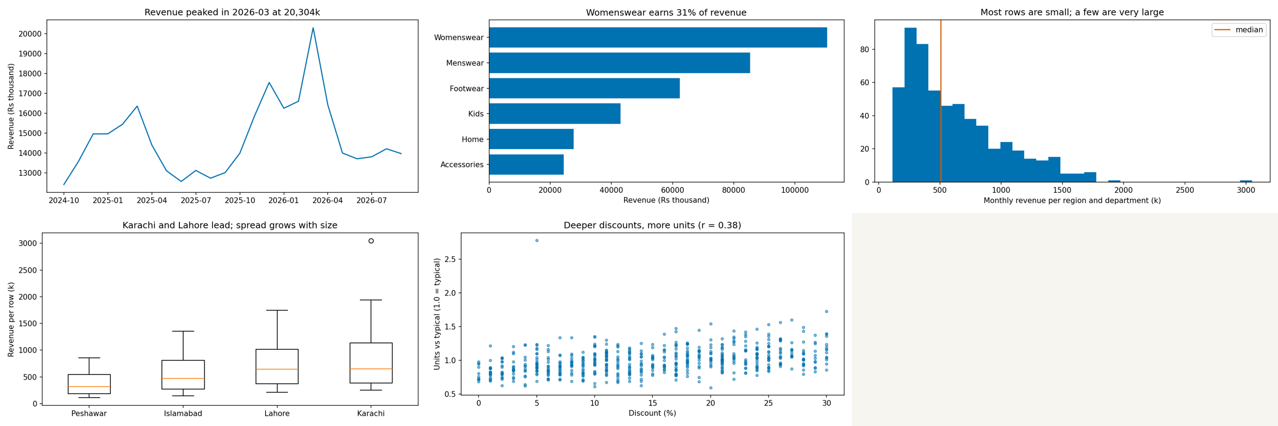
Expected charts
Peak: 2026-03. Womenswear earns 31% of revenue. Skew 1.26. Karachi and Lahore have the highest medians. Discount against units: r = 0.38.
W07-S25 · Introduction to Data Science
Notes:
Guide W07-S25. Compare with the students’ charts. Titles will differ; the findings should not.

Slide 26
Recap and exit ticket
Keep
Watch for
Next
Question first. Sorted bars from zero. Titles that say the finding.
Truncated axes, crowded pies, spaghetti lines, red against green.
Storytelling: turning charts into a one-slide story, then the midterm.
Why do bars start at zero?
When would you choose a box plot over a histogram?
Rewrite this title as a finding: Revenue by month
Assignment 2 is due at the start of the next class.
W07-S26 · Introduction to Data Science
Notes:
Guide W07-S26. Collect exit tickets. Remind about Assignment 2 and the midterm in Week 8.

